Slide 1
SWITCHING

Slide 2
Switching
A switched network consists of a series of interlinked nodes, called switches.
Switches are devices capable of creating temporary connections between two or more devices linked to the switch.
In a switched network, some of these nodes are connected to the end systems (computers or telephones, for example). Others are used only for routing.

Slide 3
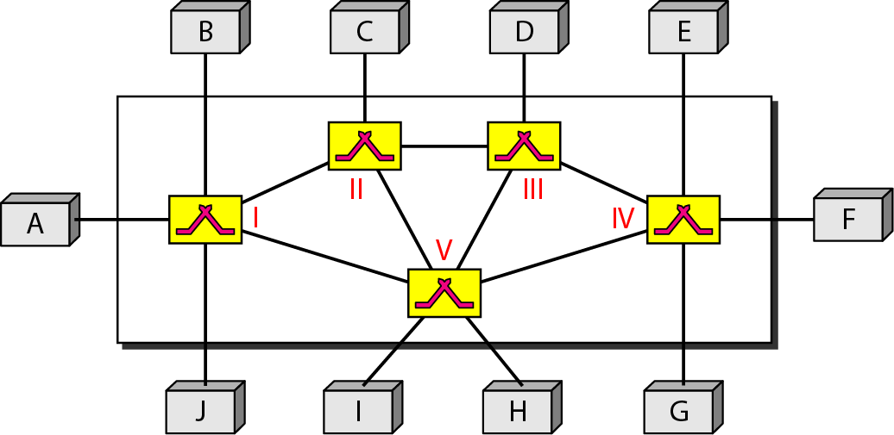
Figure Switched network

Slide 4
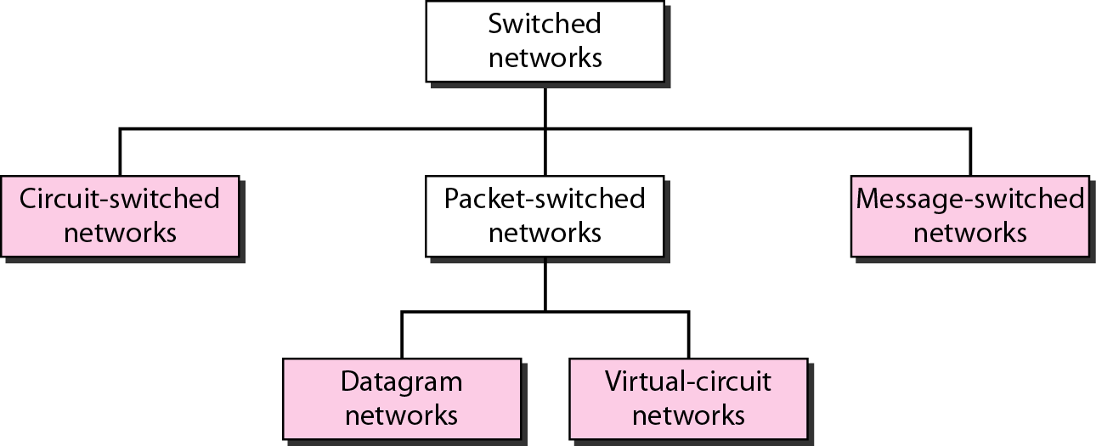
Figure Taxonomy of switched networks

Slide 5
CIRCUIT-SWITCHED NETWORKS
A circuit-switched network consists of a set of switches connected by physical links. A connection between two stations is a dedicated path made of one or more links. However, each connection uses only one dedicated channel on each link.

Slide 6

Note
A circuit-switched network is made of a set of switches connected by physical links, in which each link is divided into n channels.

Slide 7
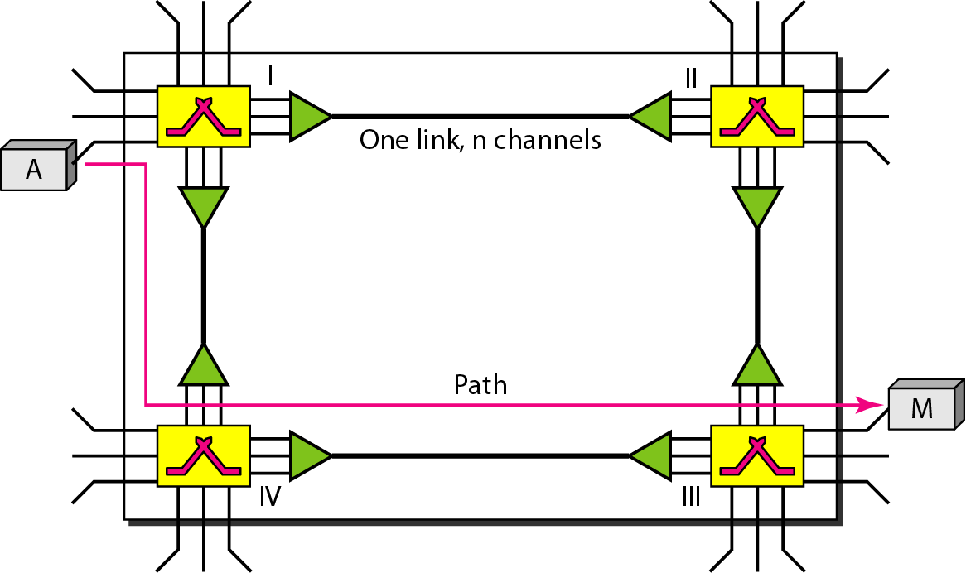
Figure:A trivial circuit-switched network

Slide 8
When end system A needs to communicate with end system M, system A needs to request a connection to M that must be accepted by all switches as well as by M itself. This is called the setup phase;
a circuit (channel) is reserved on each link, and the combination of circuits or channels defines the dedicated path. After the dedicated path made of connected circuits (channels) is established, data transfer can take place.
After all data have been transferred, the circuits are tear down.

Slide 9
Circuit switching takes place at the physical layer.
Before starting communication, the stations must make a reservation for the resources to be used during the communication. These resources, such as, switch buffers, switch processing time, and switch input/output ports, must remain dedicated during the entire duration of data transfer until the teardown phase.
Data transferred between the two stations are not packetized. The data are a continuous flow sent by the source station and received by the destination station,

Slide 10
Note
In circuit switching, the resources need to be reserved during the setup phase; the resources remain dedicated for the entire duration of data transfer until the teardown phase.

Slide 11
Three Phases
Setup Phase
Data Transfer Phase
Teardown Phase

Slide 12
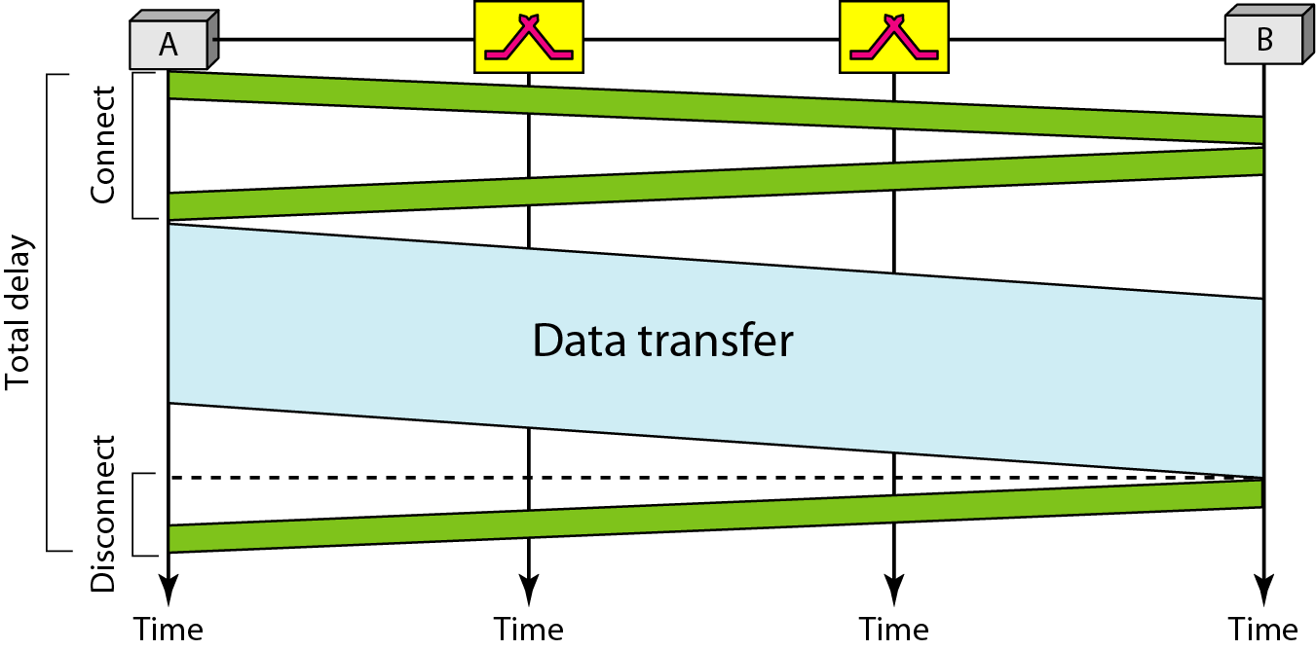
Figure: Delay in a circuit-switched network

Slide 13
Transmission delay
Transmission Delay :The time required for transmission of a message depends on the size of the message and the bandwidth of the channel.
Transmission Delay = Message size/bandwidth bps

Slide 14
Propagation Delay
Propagation Delay measures the time required for a bit to travel from the source to the destination
Propagation Delay = Distance/Propagation speed
Propagation speed - speed at which a bit travels though the medium from source to destination
For example, in a vacuum, light is propagated with a speed of 3 x 108 mbps

Slide 15
Efficiency and Delay
Circuit-switched networks are not as efficient as the other two types of networks because resources are allocated during the entire duration of the connection.
These resources are unavailable to other connections.
The delay in this type of network is minimal.
The total delay is due to the time needed to create the connection, transfer data, and disconnect the circuit

Slide 16
Note
Switching at the physical layer in the traditional telephone network uses
the circuit-switching approach.

Slide 17
DATAGRAM NETWORKS
In data communications, we need to send messages from one end system to another. If the message is going to pass through a packet-switched network, it needs to be divided into packets of fixed or variable size. The size of the packet is determined by the network and the governing protocol.

Slide 18
In packet switching, there is no resource allocation for a packet. This means that there is no reserved bandwidth on the links, and there is no scheduled processing time for each packet.
Resources are allocated on demand.
In a datagram network, each packet is treated independently of all others.
Packets in this approach are referred to as datagrams.
Datagram switching is normally done at the network layer

Slide 19
The datagram networks are sometimes referred to as connectionless networks.
The term connectionless here means that the switch (packet switch) does not keep information about the connection state.
There are no setup or teardown phases. Each packet is treated the same by a switch regardless of its source or destination.

Slide 20
Note
In a packet-switched network, there is no resource reservation;
resources are allocated on demand.

Slide 21
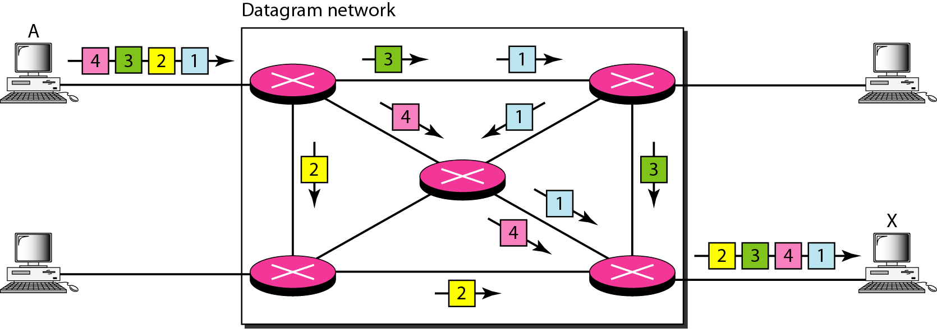
Figure: A datagram network with four switches (routers)
how the datagram approach is used to deliver four packets from station A to station X

Slide 22
Routing Table
If there are no setup or teardown phases, how are the packets routed to their destinations in a datagram network?
each switch has a routing table which is based on the destination address.
The routing tables are dynamic and are updated periodically.
The destination addresses and the corresponding forwarding output ports are recorded in the tables.

Slide 23
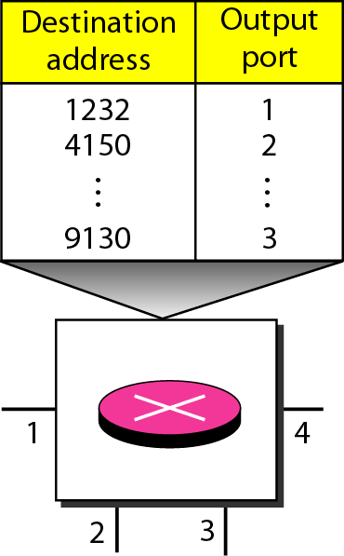
Figure: Routing table in a datagram network

Slide 24
Note
A switch in a datagram network uses a routing table that is based on the destination address.

Slide 25
Note
The destination address in the header of a packet in a datagram network
remains the same during the entire journey of the packet.

Slide 26
Efficiency and Delay
The efficiency of a datagram network is better than that of a circuit-switched network; resources are allocated only when there are packets to be transferred.
There may be greater delay in a datagram network than in a circuit network. Although there are no setup and teardown phases, each packet may experience a wait at a switch before it is forwarded.

Slide 27
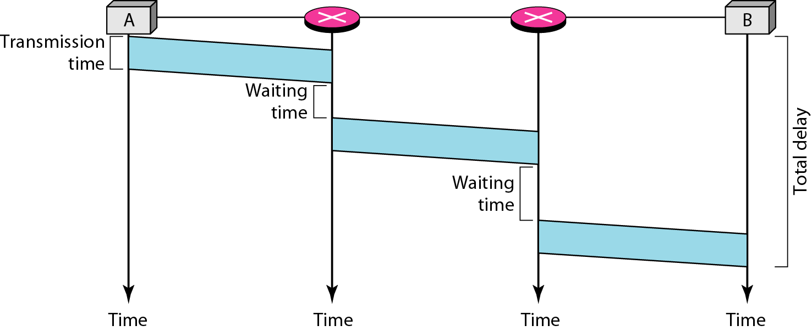
Figure :Delay in a datagram network

Slide 28
Figure :Delay in a datagram network
Total delay =3Tt+ 3Tp +WI + W2

Slide 29
Note
Switching in the Internet is done by using the datagram approach to packet switching at the network layer.

Slide 30
VIRTUAL-CIRCUIT NETWORKS
A virtual-circuit network is a cross between a circuit-switched network and a datagram network. It has some characteristics of both.

Slide 31
As in a circuit-switched network, there are setup and teardown phases in addition to the data transfer phase.
Resources can be allocated during the setup phase, as in a circuit-switched network, or on demand, as in a datagram network.
As in a datagram network, data are packetized and each packet carries an address in the header. However, the address in the header has local jurisdiction ,not end-to-end jurisdiction.
As in a circuit-switched network, all packets follow the same path established during the connection.
A virtual-circuit network is normally implemented in the data link layer, while a circuit-switched network is Physical

Slide 32
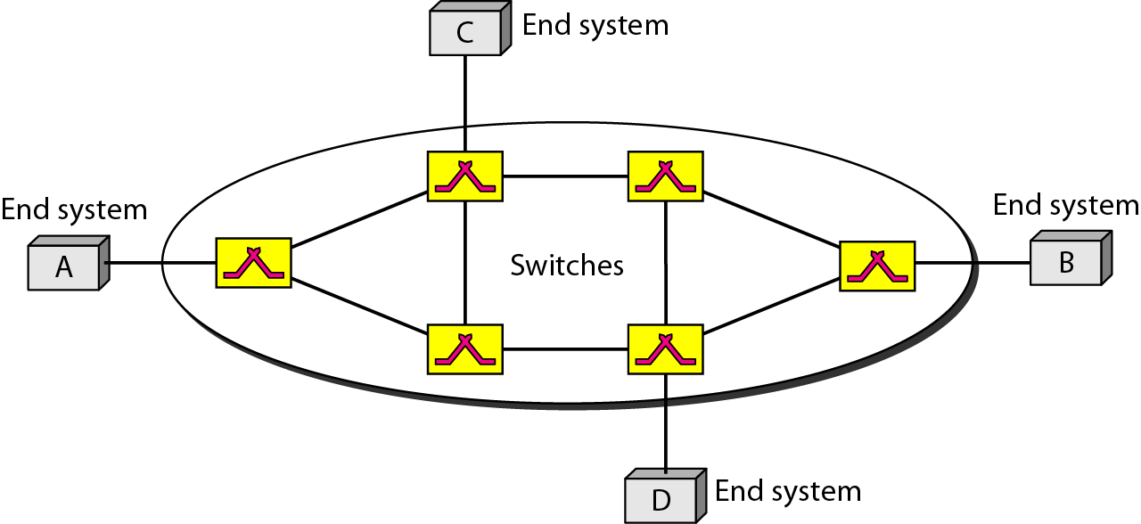
Figure: Virtual-circuit network

Slide 33
Addressing
Global Addressing A source or a destination needs to have a global address-an address that can be unique.
Virtual-Circuit Identifier The identifier that is actually used for data transfer is called the virtual-circuit identifier (VCI).
It is used by a frame between two switches. When a frame arrives at a switch, it has a VCI; when it leaves, it has a different VCl.

Slide 34
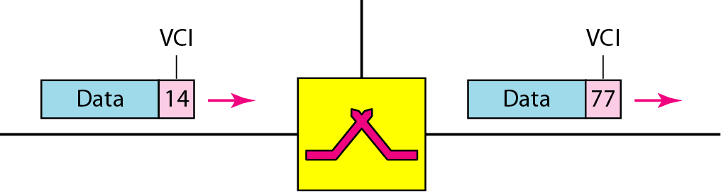
Figure: Virtual-circuit identifier

Slide 35
Three Phase
Setup
Data transfer
Teardown

Slide 36
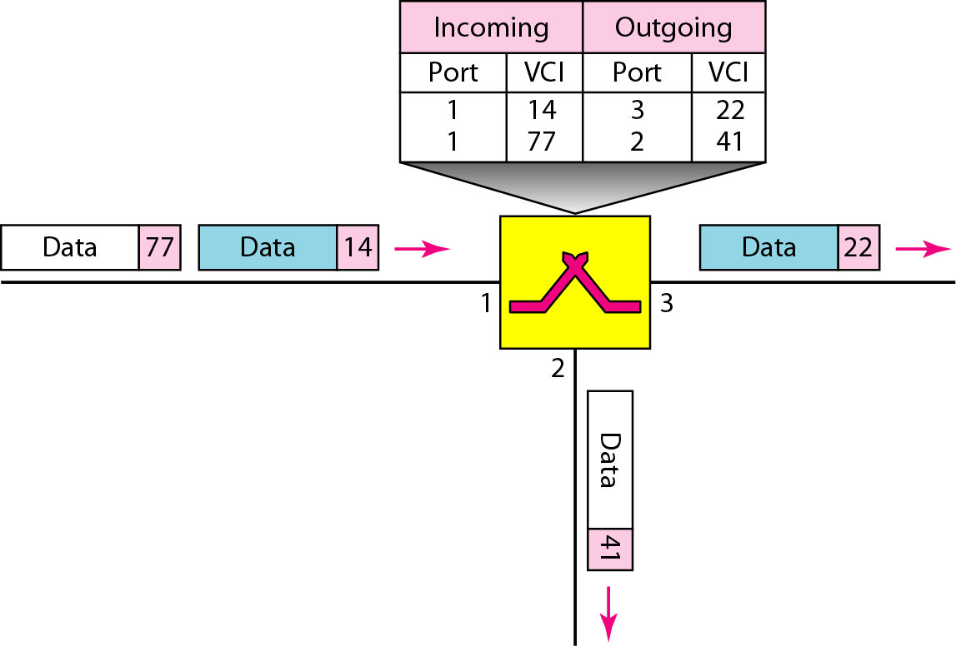
Figure: Switch and tables in a virtual-circuit network
Data Transfer Phase

Slide 37
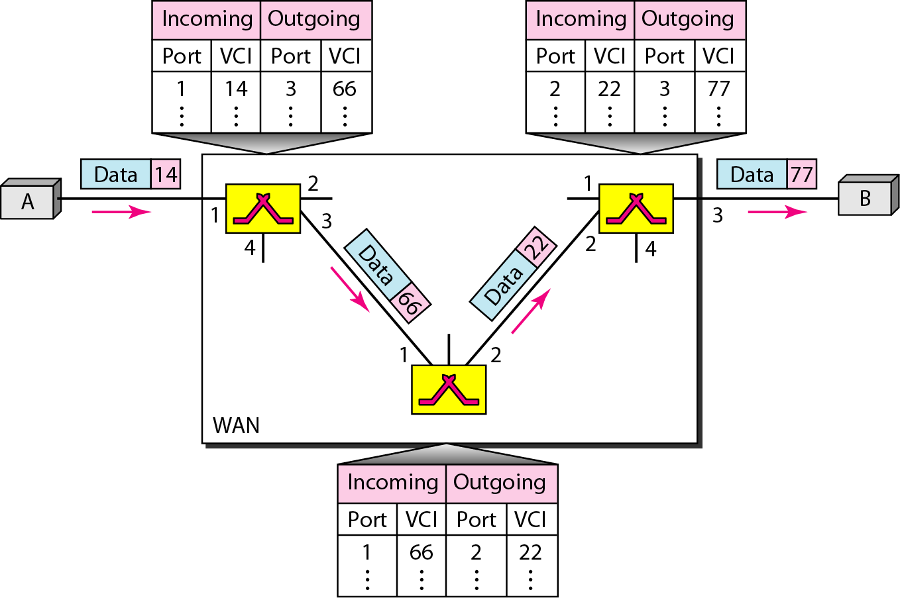
Figure :Source-to-destination data transfer in a virtual-circuit network
how a frame from source A reaches destination B and
how its VCI changes during the trip. Each switch changes the VCI and routes the frame.

Slide 38
Setup Phase
In the setup phase, a switch creates an entry for a virtual circuit. For example, suppose source A needs to create a virtual circuit to B.
Two steps are required:
the setup request and
the acknowledgment

Slide 39
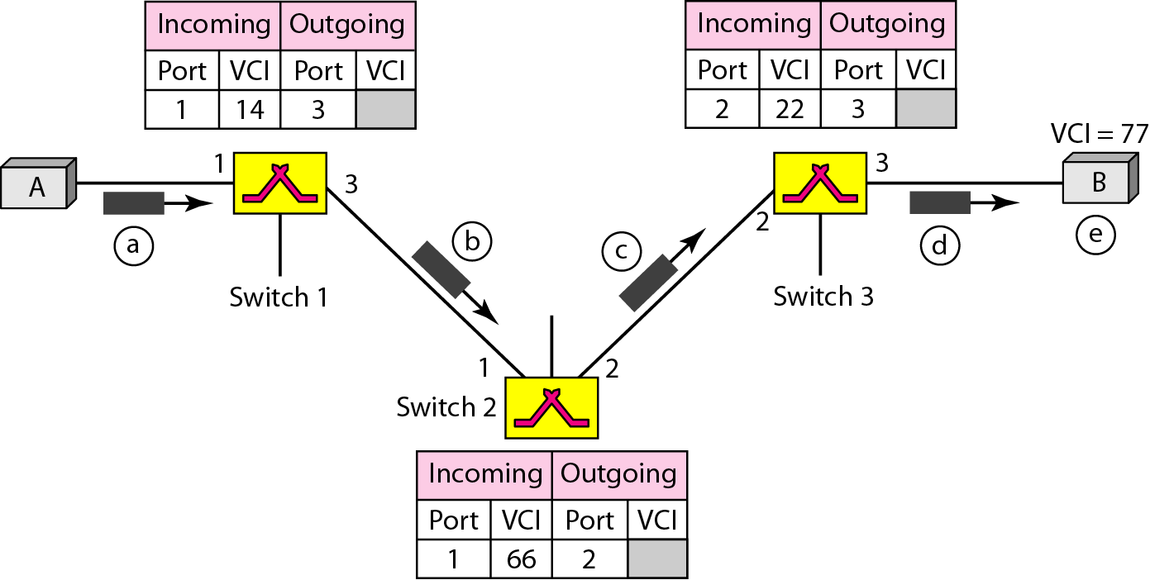
Figure: Setup request in a virtual-circuit network

Slide 40
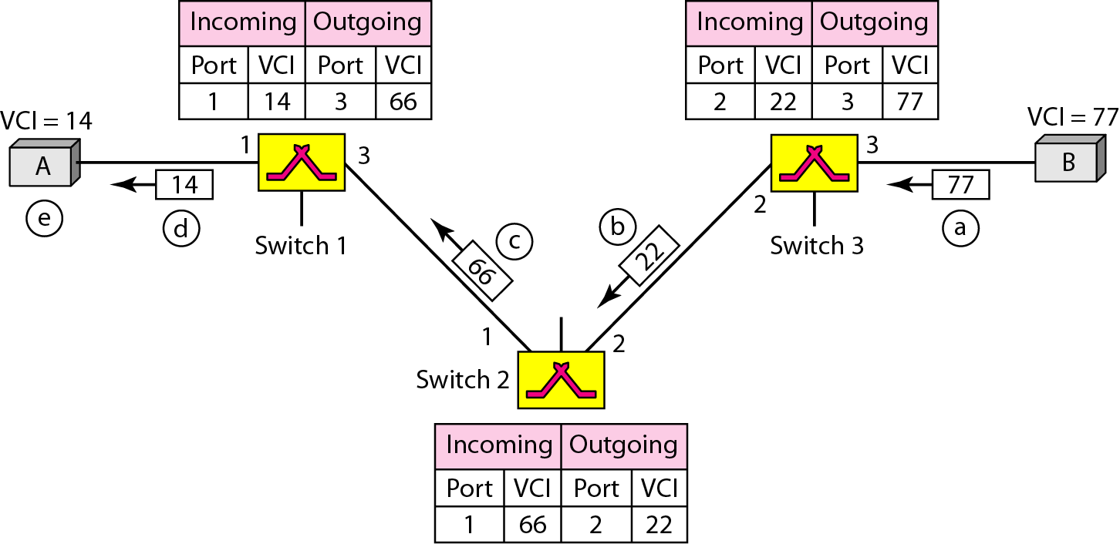
Figure: Setup acknowledgment in a virtual-circuit network

Slide 41
Teardown Phase
In this phase, source A, after sending all frames to B, sends a special frame called a teardown request. Destination B responds with a teardown confirmation frame. All switches delete the corresponding entry from their tables

Slide 42
Note
In virtual-circuit switching, all packets belonging to the same source and destination travel the same path;
but the packets may arrive at the destination with different delays if resource allocation is on demand.

Slide 43
Efficiency and Delay
Resource reservation in a virtual-circuit network can be made during the setup or can be on demand during the data transfer phase.
In the first case, the delay for each packet is the same;
in the second case, each packet may encounter different delays.
There is one big advantage in a virtual-circuit network even if resource allocation is on demand. The source can check the availability of the resources, without actually reserving it.

Slide 44
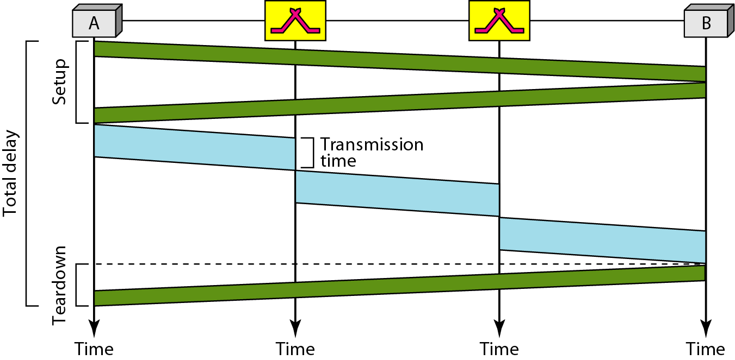
Figure :Delay in a virtual-circuit network
Total delay = 3T+ 3't + setup delay + teardown delay

Slide 45
Note
Switching at the data link layer in a switched WAN is normally
implemented by using virtual-circuit techniques.

